Slide 1

Midterm Project Presentation
DE-b7 Yifan wang
08/02/2023

Slide 2

Agenda
Project Overview
Process
Problems vs Solutions
Improvements

Slide 3

PROJECT OVERVIEW
midterm

Slide 4

Goals and tasks
Midterm
Automate ETL Process
Data Transformation
Data Analytics vs Data Visualization

Slide 5
Data source
Midterm
Sales
Inventory
Store
Product
Calendar

Slide 6
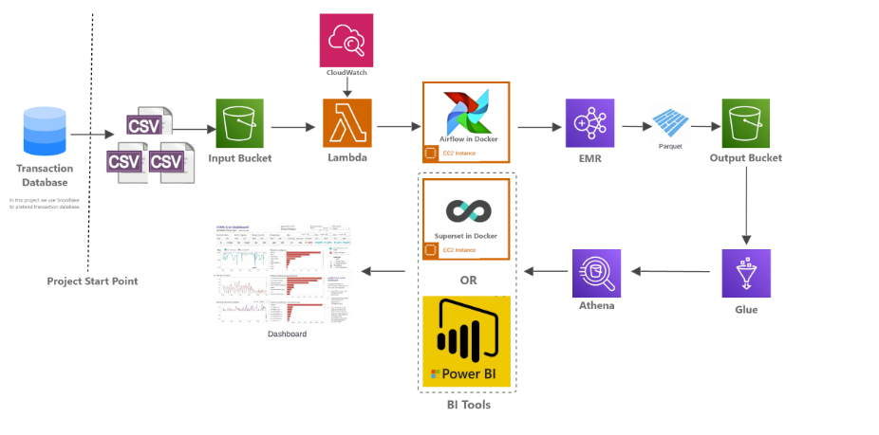
Architecture
Midterm

Slide 7
process
midterm

Slide 8
Detailed Steps and Operations
Midterm
S3 bucket (Snowflake)
Cloudwatch and Lambda
Apache Airflow
EMR
Athena and Glue
Apache Superset

Slide 9

Problems vs Solutions
midterm

Slide 10



Problems
S3 BUCKET (SNOWFLAKE)
Time Difference
Date Formatting
AWS LAMBDA
Python Version (3.7)
APACHE AIRFLOW
DAG execution failures

Slide 11


problems
EMR (ElasticMapReduce)
BI Tools
Mismatch in Business Requirement in Pyspark
Chart Types
Profit

Slide 12
Improvements
midterm

Slide 13

Project Improvements & Future Plans
Midterm
Enhanced Error Handling and Logging
Performance Optimization
Integration with More Data Sources
Implementing More Advanced Analytics
Involved in Various Data Tools

Slide 14



THANK YOU
Yifan Wang
+1 (504) 881-8657
wangyifan0705@gmail.com
WeCloudData Mideterm Project

